Slide 1
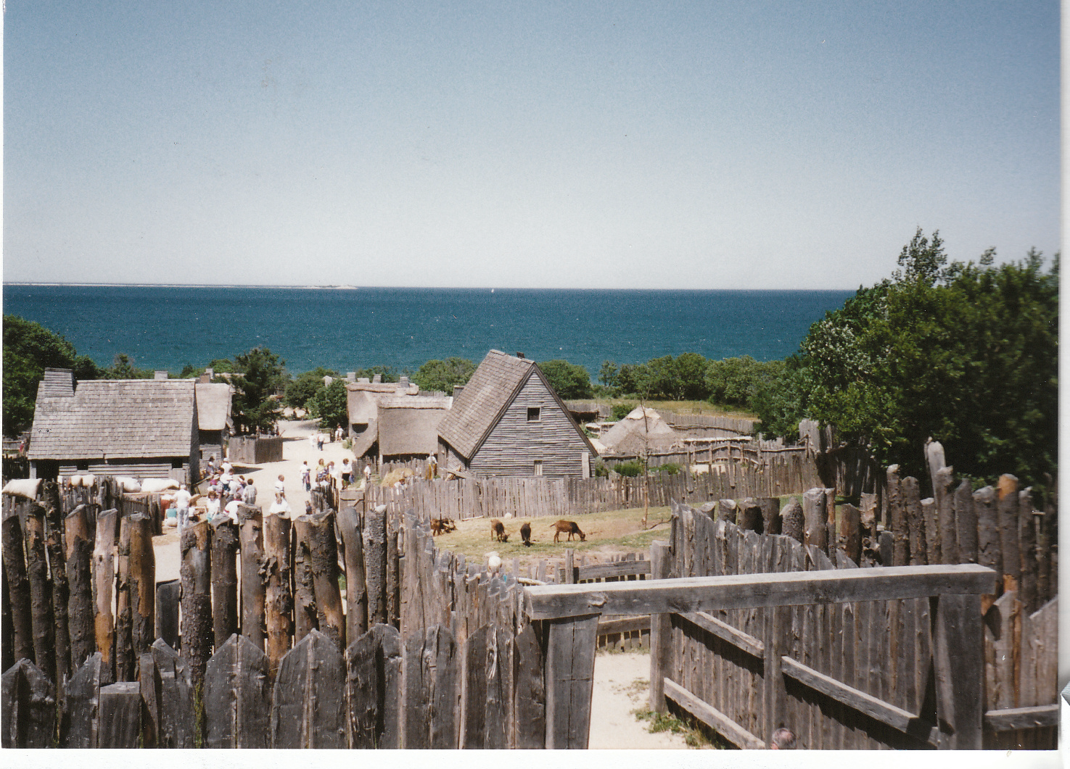
Don’t forget God’s amazing grace
God’s analysis of Israel’s history
Ezekiel 16

Slide 2
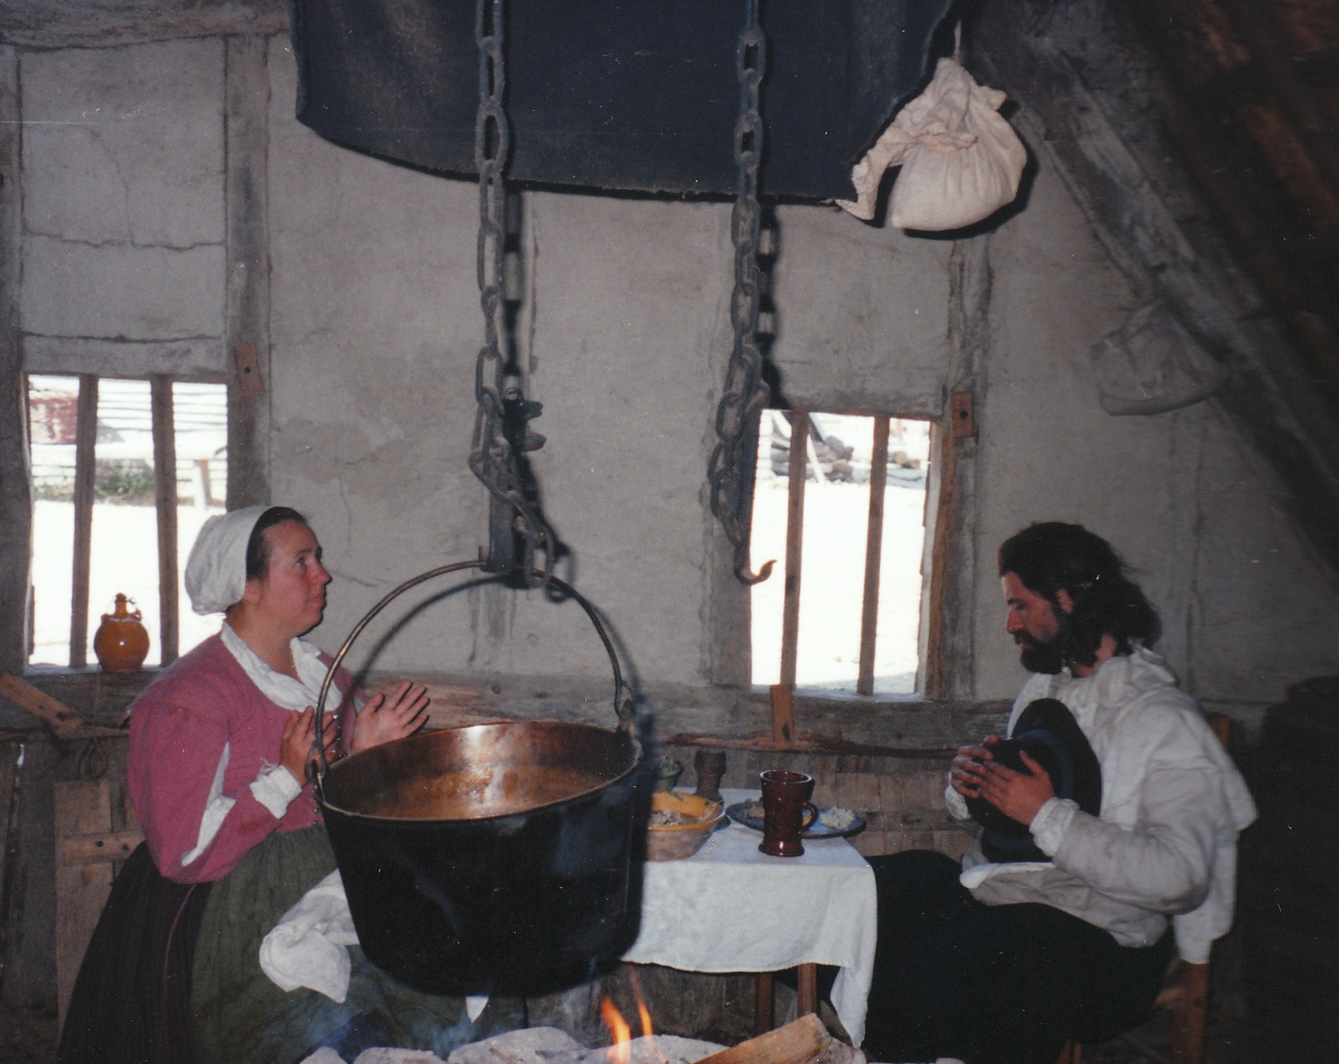
God’s analysis of Israel’s history
Ezekiel 16
American history revisited

Slide 3
God’s analysis of Israel’s history
Ezekiel 16
American history revisited
Shocked?

Slide 4
God’s analysis of Israel’s history
Ezekiel 16
American history revisited
Shocked?
Israel’s history revisited

Slide 5
God’s analysis of Israel’s history
Ezekiel 16
A foundling child vv.1-5

Slide 6
God’s analysis of Israel’s history
Ezekiel 16
A foundling child vv.1-5
Pagan roots

Slide 7
God’s analysis of Israel’s history
Ezekiel 16
A foundling child vv.1-5
The gracious benefactor vv.6-14

Slide 8
God’s analysis of Israel’s history
Ezekiel 16
A foundling child vv.1-5
The gracious benefactor vv.6-14
Hannah’s song: “The Lord brings death and makes alive” 1 Sam 2:6

Slide 9
God’s analysis of Israel’s history
Ezekiel 16
A foundling child vv.1-5
The gracious benefactor vv.6-14
Hannah’s song: “The Lord brings death and makes alive” 1 Sam 2:6
“embroidery” and “fine linen” (v.10) used for tabernacle + priest’s robes.

Slide 10
God’s analysis of Israel’s history
Ezekiel 16
A foundling child vv.1-5
The gracious benefactor vv.6-14
Amazing grace

Slide 11
God’s analysis of Israel’s history
Ezekiel 16
A foundling child vv.1-5
The gracious benefactor vv.6-14
Amazing grace
God-given splendour (v.14)

Slide 12
God’s analysis of Israel’s history
Ezekiel 16
A foundling child vv.1-5
The gracious benefactor vv.6-14
Amazing grace
God-given splendour (v.14)
Flagrant wantonness (vv.15-34)

Slide 13
God’s analysis of Israel’s history
Ezekiel 16
A foundling child vv.1-5
The gracious benefactor vv.6-14
Amazing grace
God-given splendour (v.14)
Flagrant wantonness (vv.15-34)
God’s jealous anger

Slide 14
God’s analysis of Israel’s history
Ezekiel 16
A foundling child vv.1-5
The gracious benefactor vv.6-14
Amazing grace
God-given splendour (v.14)
Flagrant wantonness (vv.15-34)
God’s jealous anger
Two kinds of jealousy

Slide 15
God’s analysis of Israel’s history
Ezekiel 16
A foundling child vv.1-5
The gracious benefactor vv.6-14
Religious prostitution vv.15-22

Slide 16
God’s analysis of Israel’s history
Ezekiel 16
A foundling child vv.1-5
The gracious benefactor vv.6-14
Religious prostitution vv.15-22
Political prostitution vv.23-24

Slide 17
God’s analysis of Israel’s history
Ezekiel 16
A foundling child vv.1-5
The gracious benefactor vv.6-14
Religious prostitution vv.15-22
Political prostitution vv.23-24
3. The judicial verdict and sentence vv.35-52

Slide 18
God’s analysis of Israel’s history
Ezekiel 16
A foundling child vv.1-5
The gracious benefactor vv.6-14
Religious prostitution vv.15-22
Political prostitution vv.23-24
3. The judicial verdict and sentence vv.35-52
Stage 1. Public humiliation

Slide 19
God’s analysis of Israel’s history
Ezekiel 16
A foundling child vv.1-5
The gracious benefactor vv.6-14
Religious prostitution vv.15-22
Political prostitution vv.23-24
3. The judicial verdict and sentence vv.35-52
Stage 1. Public humiliation
Stage 2. Reminder of pagan origins v.45

Slide 20
God’s analysis of Israel’s history
Ezekiel 16
A foundling child vv.1-5
The gracious benefactor vv.6-14
Religious prostitution vv.15-22
Political prostitution vv.23-24
3. The judicial verdict and sentence vv.35-52
Stage 1. Public humiliation
Stage 2. Reminder of pagan origins v.45
The sins of Samaria v.46 (see ch.23:1-10)

Slide 21
God’s analysis of Israel’s history
Ezekiel 16
A foundling child vv.1-5
The gracious benefactor vv.6-14
Religious prostitution vv.15-22
Political prostitution vv.23-24
3. The judicial verdict and sentence vv.35-52
Stage 1. Public humiliation
Stage 2. Reminder of pagan origins v.45
The sins of Samaria v.46 (see ch.23:1-10)
The sins of Sodom v.49: arrogance, gluttony, callousness, indifference

Slide 22
God’s analysis of Israel’s history
Ezekiel 16
A foundling child vv.1-5
The gracious benefactor vv.6-14
Religious prostitution vv.15-22
Political prostitution vv.23-24
The judicial verdict and sentence vv.35-52
An amazing promise vv.53-63

Slide 23
God’s analysis of Israel’s history
Ezekiel 16
A foundling child vv.1-5
The gracious benefactor vv.6-14
Religious prostitution vv.15-22
Political prostitution vv.23-24
The judicial verdict and sentence vv.35-52
An amazing promise vv.53-63
Restoration promise: Israel, Sodom and Samaria v.53

Slide 24
God’s analysis of Israel’s history
Ezekiel 16
A foundling child vv.1-5
The gracious benefactor vv.6-14
Religious prostitution vv.15-22
Political prostitution vv.23-24
The judicial verdict and sentence vv.35-52
An amazing promise vv.53-63
Restoration promise: Israel, Sodom and Samaria v.53
Disgrace and shame

Slide 25
God’s analysis of Israel’s history
Ezekiel 16
A foundling child vv.1-5
The gracious benefactor vv.6-14
Religious prostitution vv.15-22
Political prostitution vv.23-24
The judicial verdict and sentence vv.35-52
An amazing promise vv.53-63
Restoration promise: Israel, Sodom and Samaria v.53
Disgrace and shame
Deep repentance

Slide 26
God’s analysis of Israel’s history
Ezekiel 16
A foundling child vv.1-5
The gracious benefactor vv.6-14
Religious prostitution vv.15-22
Political prostitution vv.23-24
The judicial verdict and sentence vv.35-52
An amazing promise vv.53-63
Lessons

Slide 27
God’s analysis of Israel’s history
Ezekiel 16
A foundling child vv.1-5
The gracious benefactor vv.6-14
Religious prostitution vv.15-22
Political prostitution vv.23-24
The judicial verdict and sentence vv.35-52
An amazing promise vv.53-63
Lessons
A covenant comes with conditions

Slide 28
God’s analysis of Israel’s history
Ezekiel 16
A foundling child vv.1-5
The gracious benefactor vv.6-14
Religious prostitution vv.15-22
Political prostitution vv.23-24
The judicial verdict and sentence vv.35-52
An amazing promise vv.53-63
Lessons
A covenant comes with conditions
Beware the error of forgetfulness

Slide 29
God’s analysis of Israel’s history
Ezekiel 16
A foundling child vv.1-5
The gracious benefactor vv.6-14
Religious prostitution vv.15-22
Political prostitution vv.23-24
The judicial verdict and sentence vv.35-52
An amazing promise vv.53-63
Lessons
A covenant comes with conditions
Beware the error of forgetfulness
Need for God-given reminders

Slide 30
God’s analysis of Israel’s history
Ezekiel 16
A foundling child vv.1-5
The gracious benefactor vv.6-14
Religious prostitution vv.15-22
Political prostitution vv.23-24
The judicial verdict and sentence vv.35-52
An amazing promise vv.53-63
Lessons
A covenant comes with conditions
Beware the error of forgetfulness
Use our God-given reminders
Joseph’s sons, “Manasseh” – ‘forget’ and “Ephraim” – ‘doubly fruitful’!

Slide 31
God’s analysis of Israel’s history
Ezekiel 16
A foundling child vv.1-5
The gracious benefactor vv.6-14
Religious prostitution vv.15-22
Political prostitution vv.23-24
The judicial verdict and sentence vv.35-52
An amazing promise vv.53-63
Lessons
A covenant comes with conditions
Beware the error of forgetfulness
Use our God-given reminders
Modern equivalents?

